Slide 1
Resilience of Takaful
7th African Islamic Finance Summit : 8th July 2021
Hyatt Regency, Dar-es-salaam, Tanzania.
DR HUDA AHMED YUSSUF
(PhD in Comparative Finance)

Slide 2
TABARRU
ﲼ ﲽ ﲾ ﲿﳀ
Contract of conventional insurance Vs of Takaful
Purify our Intentions
“Get rid of the selfish/ Utilitarian approach”

Slide 3
EFFICIENCY
Capital markets
(1) Risk Pooling & Risk Bearing
(3) Financial intermediation
(2) Financial services
Solvency regulations
Takaful Operator
Contribution
Policy holders
Compensation
Loading value
Demand for Takaful
Market Structure
Profitability of Takaful operators
Efficiency of takaful operator in all 3 functions
operator’s Financial Resilience

Slide 4
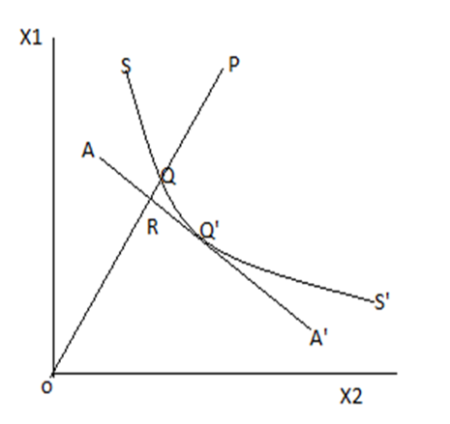
MEASUREMENTS OF EFFICIENCY
DATA ENVELOPMENT ANALYSIS
Value Added (production) Approach
Managerial Efficiency
Outputs
Claims paid and additions to reserve
Real invested assets
Technical Efficiency
Scale Efficiency
Revenue Efficiency
Inputs
Labour
Capital
Business services
Cost Efficiency
Profit Efficiency

Slide 5
TAKAFUL OPERATORS CAN BE MORE EFFICIENT THAN CONVENTIONAL INSURERS
TECHNICAL EFFICIENCY
COST EFFICIENCY
REVENUE EFFICIENCY
$$\overline{{TE}_{T}}$$
$$> \overline{{TE}_{C}}$$
$$\overline{{CE}_{C}}$$
$$= \overline{{CE}_{T}}$$
$$\overline{{RE}_{T}}$$
$$> \overline{{RE}_{C}}$$
$$\overline{{AE}_{C}}$$
$$> \overline{{AE}_{T}}$$
2009 -
17%
$$\overline{{PTE}_{T}}$$
2009 -
32%
$$\overline{{RE}_{T}}$$
2012 -
36.2%
$$\overline{{AE}_{C}}$$
2010 -
12.7%
$$\overline{{PTE}_{T}}$$
2013 -
23.1%
$$\overline{{AE}_{C}}$$
2010 -
23%
$$\overline{{RE}_{T}}$$
2007 -
2.7%
$$\overline{{SE}_{T}}$$
2014 -
18.9%
$$\overline{{AE}_{C}}$$
Size Efficiency
+ve
Financial Resilience

Slide 6
How efficiency can be maximized
Proper actuarial valuations
Innovative investments
Input minimization
Optimum size of the Takaful firm

